Slide 1

Web App for Detecting Malicious and Fradulent activities over Internet
Saumya Sharma

Slide 2
Through the medium of this project it is being told that how the technologies like, Android app development, Data mining, machine learning, API integration has helped in the successful completion in working of this project.

Slide 3

Purpose of This App
This project involves developing a comprehensive system for detecting and preventing malicious activities during video calls on messaging platforms. The core components include a web application, an Android app, and a machine learning model. The entire system aims to empower users to identify and mitigate potential threats, fostering a more secure and resilient digital communication environment. The focus is on addressing privacy concerns and protecting users from deceptive practices, such as fake video calls leading to blackmail attempts.

Slide 4
Technologies Used
Technologies Used are :
-Android Studio
- XML Code
- Java Code(Backend)
- Data sortation using techniques of machine learning
- Android Emulator

Slide 5
CODE:-
EditText android:id="@+id/phoneNumberEditText" android:layout_width="match_parent" android:layout_height="wrap_content" android:layout_marginTop="16dp" android:hint="Enter Phone Number" android:inputType="phone" android:layout_centerHorizontal="true"/> <Button android:id="@+id/proceedButton" android:layout_width="wrap_content" android:layout_height="wrap_content" android:text="Proceed" android:layout_below="@id/phoneNumberEditText" android:layout_marginTop="16dp" android:layout_centerHorizontal="true" android:onClick="onProceedButtonClick" />
<TextView android:id="@+id/checkTextView" android:layout_width="wrap_content" android:layout_height="wrap_content" android:text="Check using Paytm/Facebook/Truecaller" android:layout_centerHorizontal="true" android:layout_marginTop="16dp"/> <Button android:id="@+id/paytmButton" android:layout_width="wrap_content" android:layout_height="wrap_content" android:text="Paytm" android:layout_below="@id/checkTextView" android:layout_marginTop="16dp" android:layout_centerHorizontal="true" android:onClick="onPaytmButtonClick" />

Slide 6
USER INTERFACE
It explains how the application looks like when its run:-
At first the user enters the suspected mobile number then clicks on the “CHECK” Button.
The number gets checked through various platforms like UPI apps, trucaller and social Networking sites if the identity all over is different then the Number is found to be suspected and the user is asked to complain to the cyber security.

Slide 7
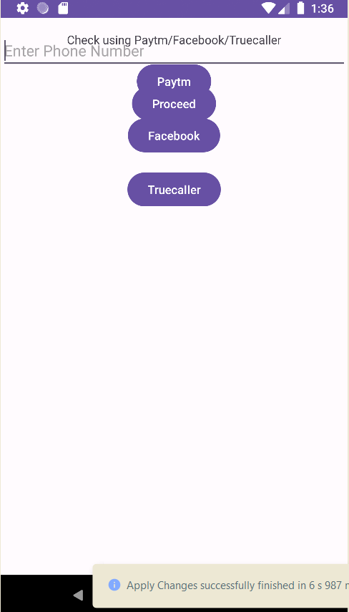
This is how the app looks like the user enters the
Number and that number is checked through these
Platforms.

